Slide 1

A really nice product.. The all-in-one tool to supercharge your productivity

Slide 2
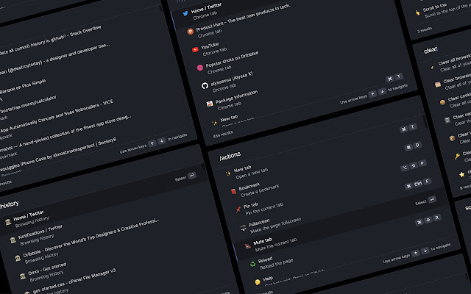
Omni
What is Omni?
Omni is a easy to use chrome extension which can ease the use of shortcuts from your finger tips rather than moving your lazy hands
It can be found in:https://chrome.google.com/webstore/detail/omni/mapjgeachilmcbbokkgcbgpbakaaeehi?hl=en&authuser=0

Slide 3



Founded by:
Alyssa X
Alyssa is a designer, full-stack developer, and entrepreneur.
She is the founder of Sonuum & several other ventures.
Best Woman Maker of 2018 by Maker Mag

Slide 4
1. Problem which it tackles
Let’s start with the first set of slides

Slide 5
This is specially helpful to the coding and devolper community as it helps them integrate their workspace to their needs.

Slide 6

The target of this product is
It is for professionals and devolpers.
For students learning coding.
And Mainly for bussiness applications.
This can drastically impact the way we utilize the time and help us in smooth operation

Slide 7

Specialty of this product
The best thing about this is it is open source and can be accessed through github and it can molded into any manner required by the user and as developers use more than chrome such as chromium and etc it is very useful and flexible.

Slide 8

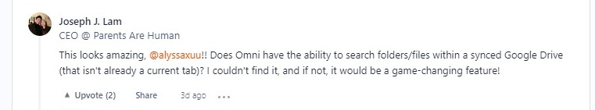
Why should you choose this product?

Slide 9
Conclusion
This shortcut application was made by one person, it was one person who wrote all the code and integrated into the browser
And I request everyone to try this piece of software cause it is actually very useful for every person using chrome.

Slide 10
26,124
Approximately these many users are using this Application.

Slide 11

Thanks!
Any questions?
You can find me at:
@sudeep_was_found
& sudeepbanerjeechopra@hotmail.com

Slide 12

Credits
Special thanks to all the people who made and released these awesome resources for free:
Presentation template by SlidesCarnival
Photographs by Product hunt
And special thanks to Sudeep

Slide 13



Under the guidance of
Mohammed Rahil Azeez C.E.O of Rentera
Rentera.in
Mohammed Junaid Moulana C.M.O of Rentera
Rentera.in
Mohammed Abdul Azeem C.O.O of Rentera
Rentera.in

